Slide 1

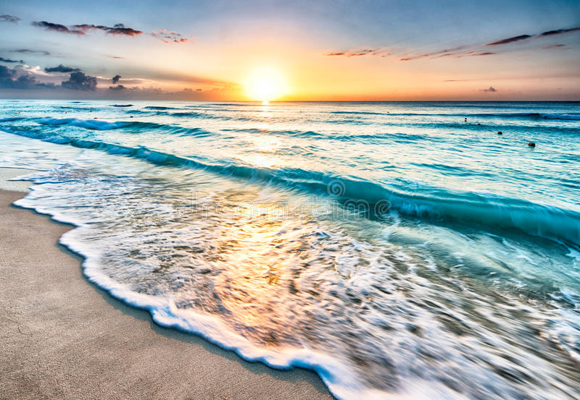
Smart Beach by Bruce County
for Dr. Alex Smith
Sanjeev Kumar - Professor
Brunilda Xhaferllari – Project Manager
Rich Freeman – Faculty Mentor
AI Team:
Janvi Patel
Fangji Chen
Scaria Ouseph Kurian
Date: 02-09-2023
Notes:
Image: 12019 (2016) Ocean waves crashing on shore during daytime https://pixabay.com/photos/beach-sea-sunset-sun-sunlight-1751455/

Slide 2
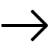
Additional activities since the last report(Updates of 3 weeks)
Work:
We were working on Image Classification.
There are few models to compare accuracy.
CSRNet
Faster R-CNN
DenseNet
Notes:
Padrinan, Miguel (n.d.). Email blocks on Gray Surface. Accessed on January 16th, 2023 from https://www.pexels.com/photo/email-blocks-on-gray-surface-1591062/

Slide 3
Image classification
Individual Status Report - Janvi
Main purpose of Image classification is for crowd density and camera angle.
Some of the models that work best for crowd density are:
CSRNet.
DenseNet.
R-CNN.
All these algorithms work in different situations same as for crowd counting.
CSRNet is the short form of Convolution Neural network that uses feature extraction for crowd density classification.
DenseNet is specialized for image classification tasks.
R-CNN Region-Based Convolution Neural Network, the major benefit of which can be classified based on region segmentation.
All these models are trained on the dataset for this specific project to classify the images.
The classification, for now, is done in 3 classes.
One, in which people can be identified clearly.
Second, in which the images are not too crowded or the camera distance is not so far.
Third, in which images are more crowded and the distance is far (forming a cluster).

Slide 4
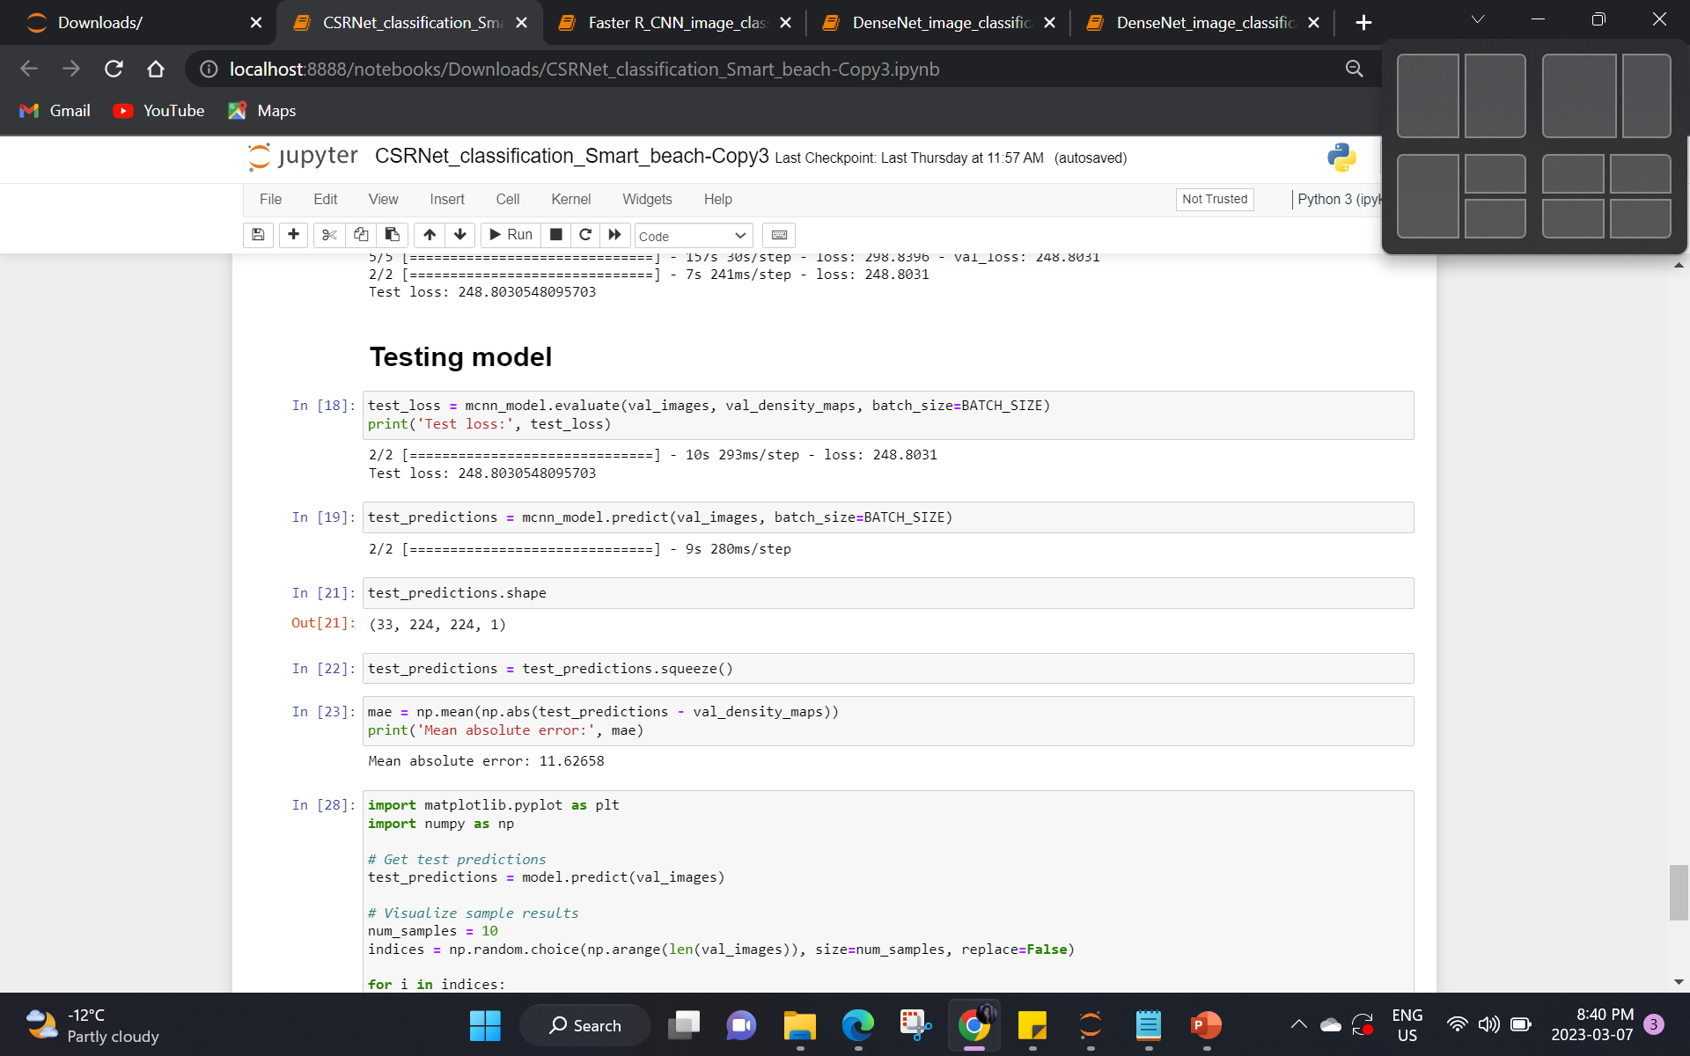
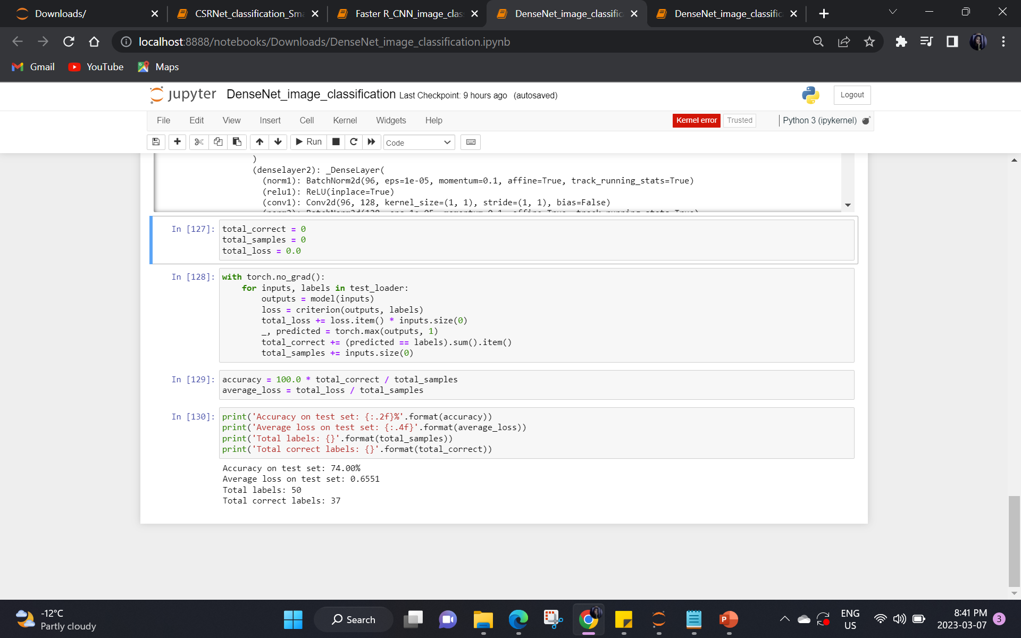
IMAGE CLASSIFICATION -- Model Comparison
CSRNet
DenseNet

Slide 5
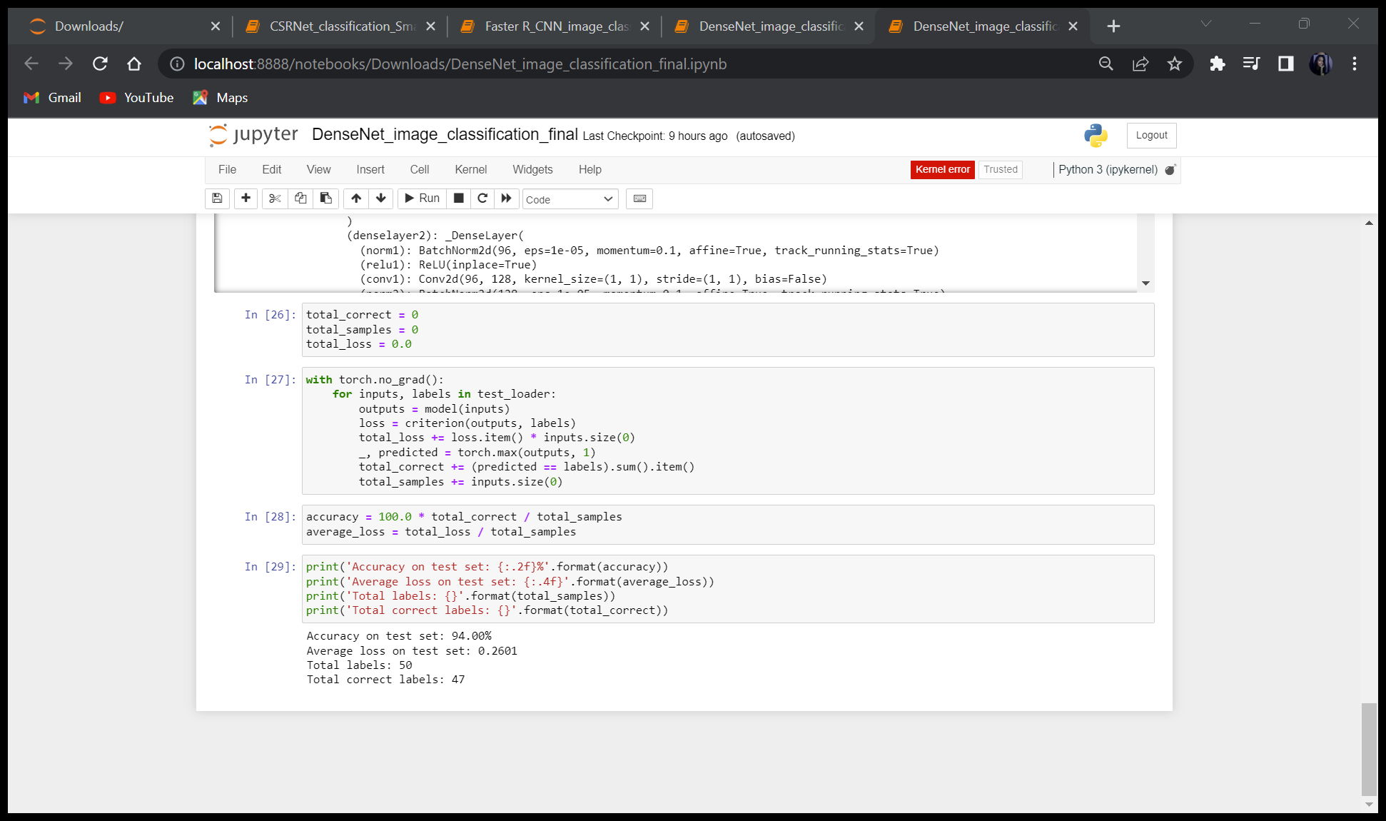
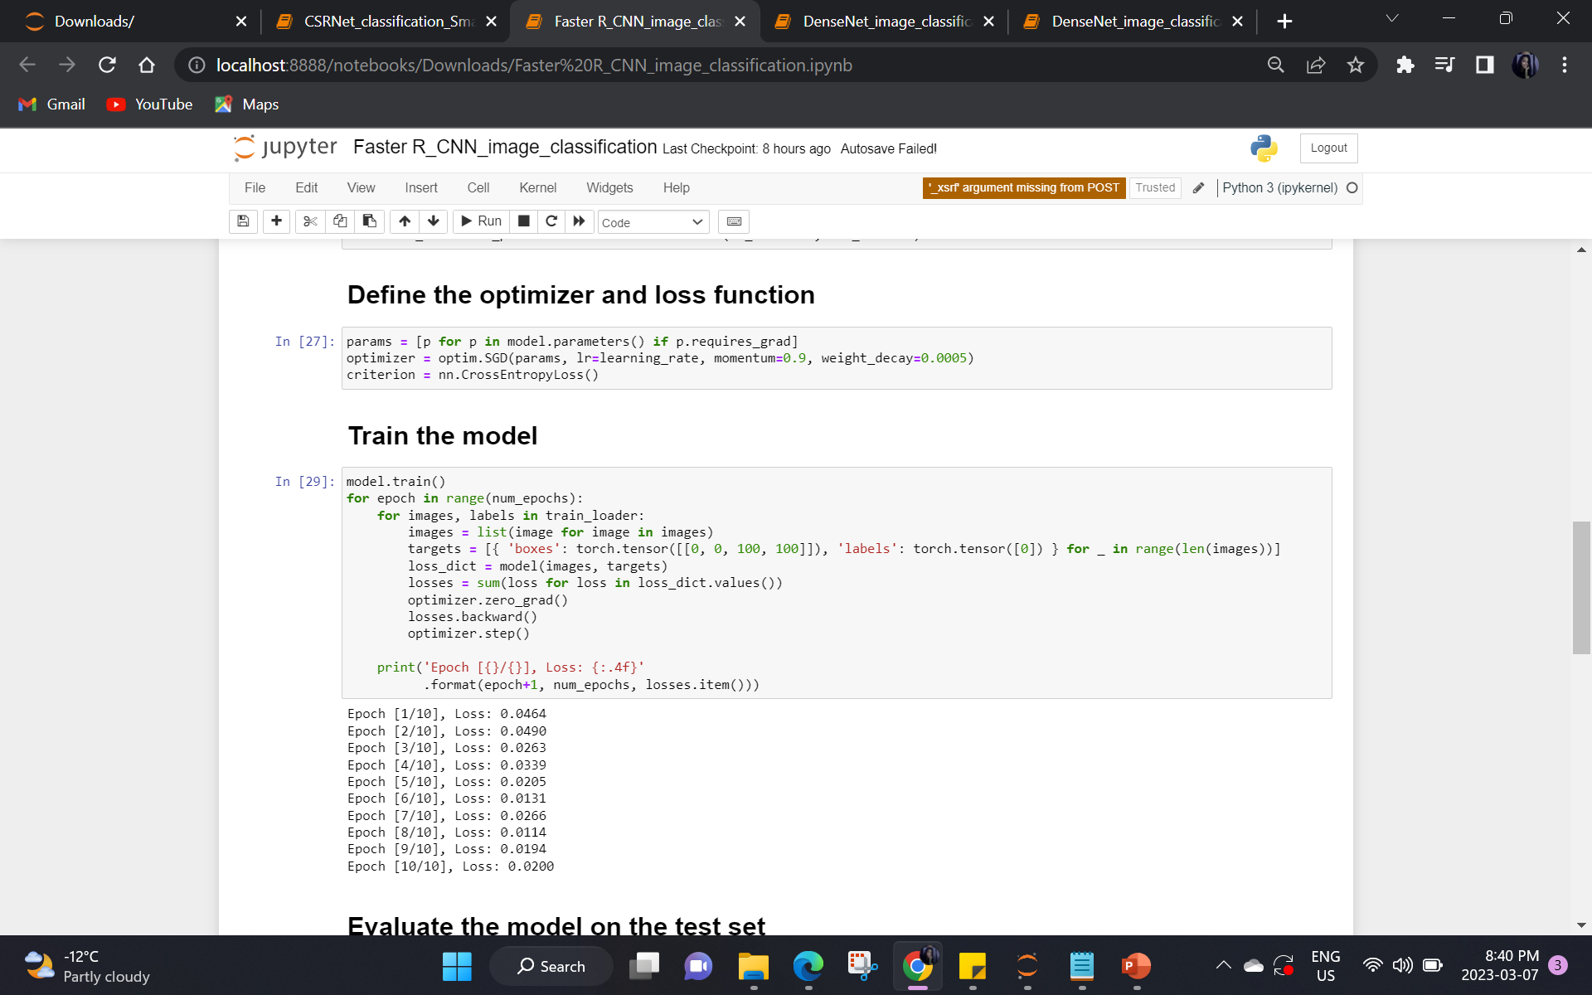
IMAGE CLASSIFICATION -- MODEL COMPARISON
DenseNet with 50 epoch
Faster RCNN

Slide 6
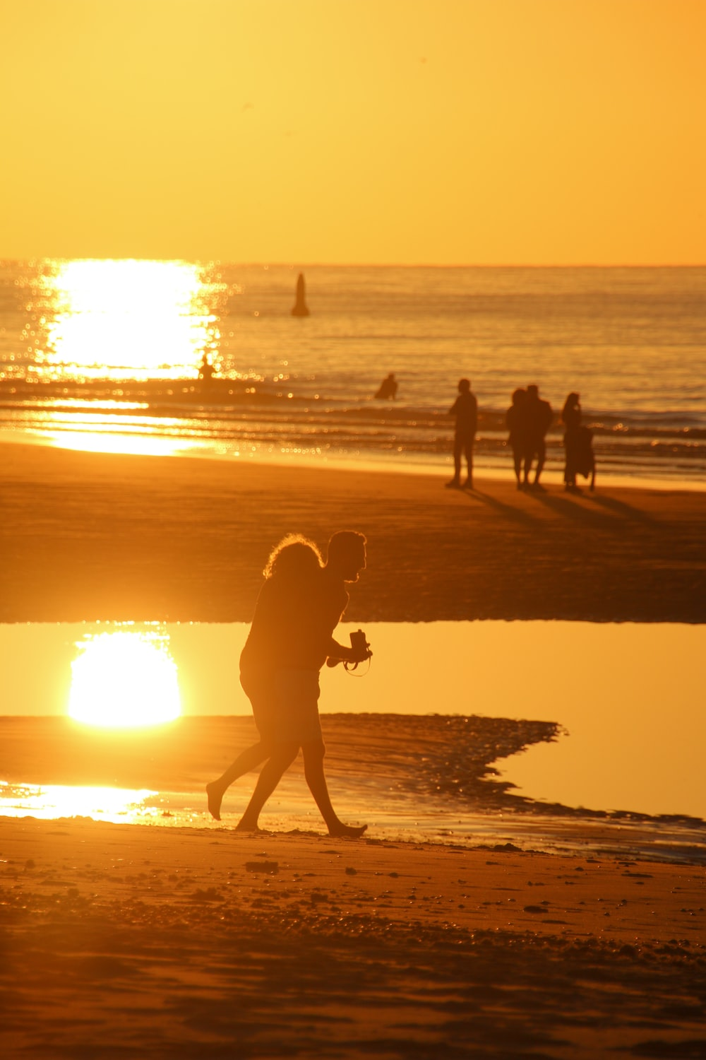
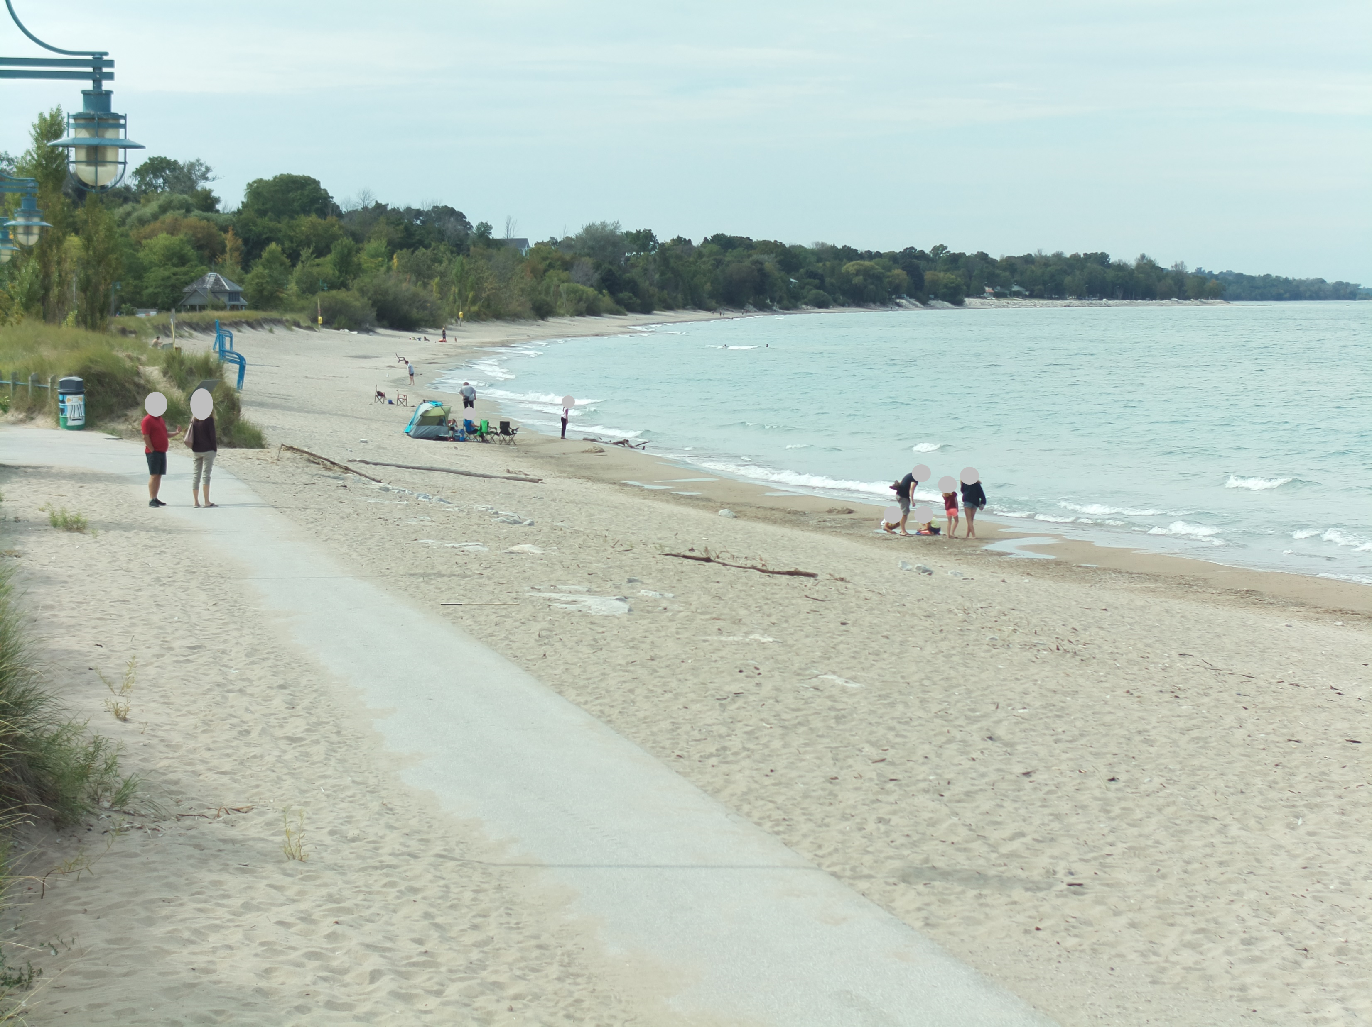
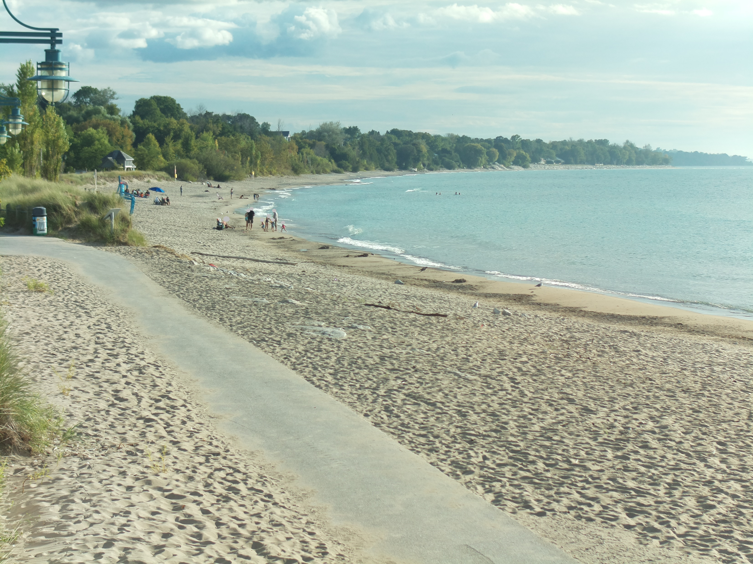
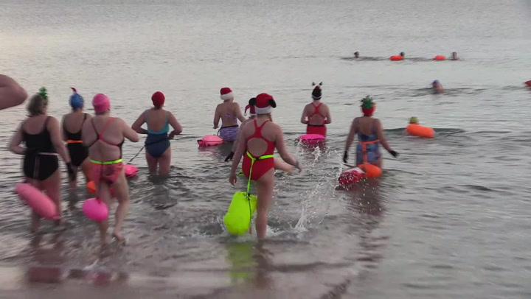
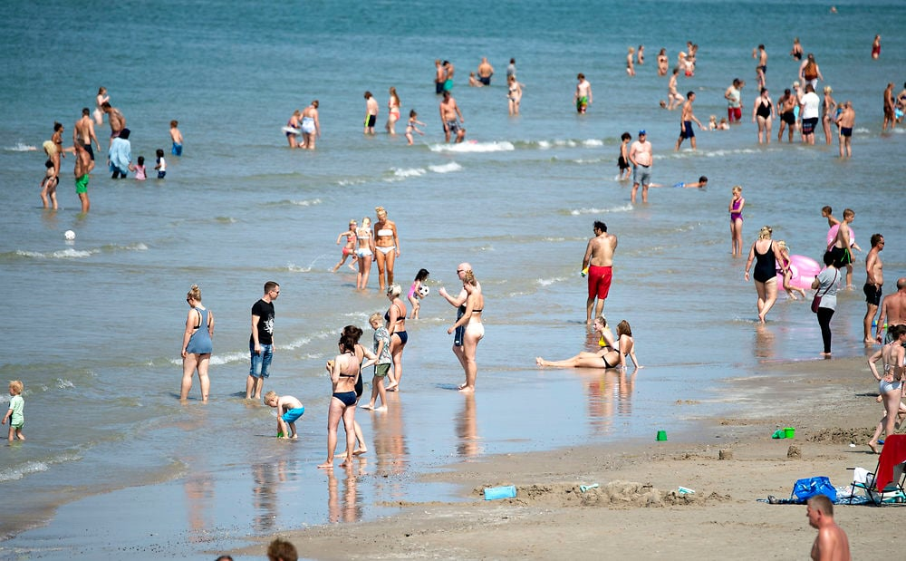
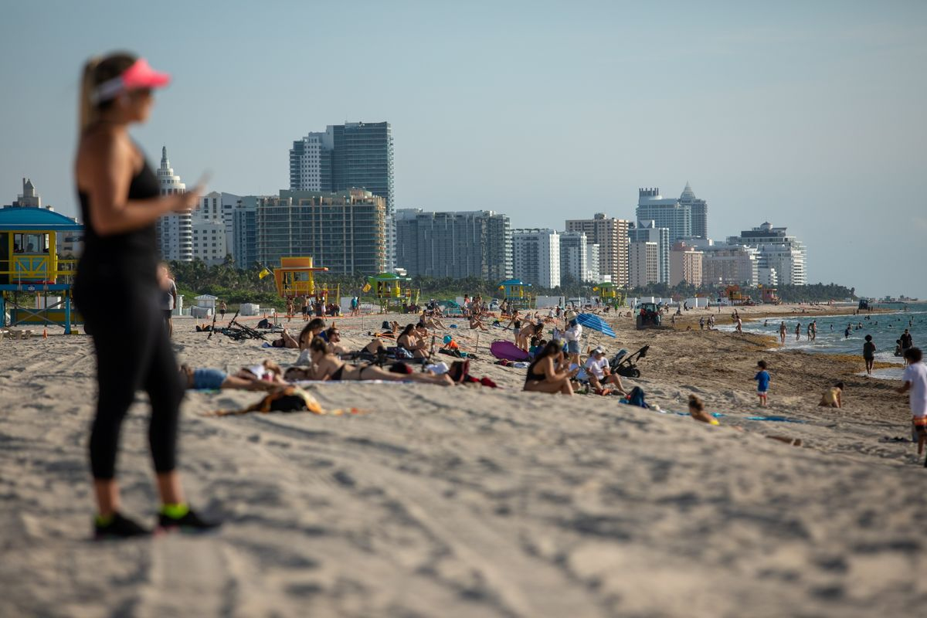
Image Classification -- results
Class : 0​
Class : 1
Class : 2
Bruce Beach(n.d.)
Bruce Beach(n.d.)
Steven(2021)
Jayme(2020.6)

Slide 7
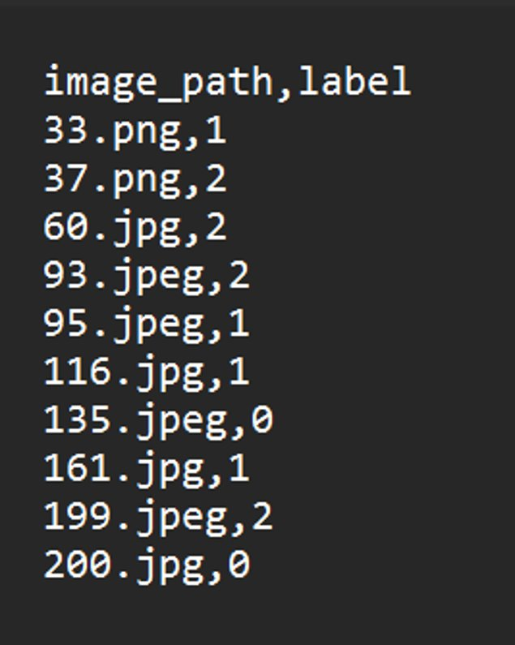
Image Classification -- result
As we can see here the model provides a CSV file including the predicted labels and image file name.

Slide 8
Complexity
CSRNet:
The CSRNet model has an average loss of around 248. Making the accuracy way lower.
DenseNet:
The DenseNet model with 10 epochs gave an accuracy of about 74%. After increasing the epoch count to 50 the accuracy increased drastically to 94%.
Faster R-CNN:
The RCNN model has the lowest average loss, even less than 0.05. Which will give the best output for classification. Also, RCNN will allow us to classify on the bases of the region as well.

Slide 9
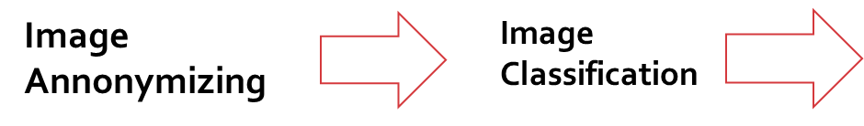
Activities to be Completed before Next report:
Testing the RCNN model
Applying different crowd-counting models on different classes and finalizing the models for each class
Final Testing of the architecture
Plan for now?
Crowd Counting
Notes:
Olexa, Peter (n.d.) A Person Making a Schedule. Accessed on January 18th, 2023 from https://www.pexels.com/photo/a-person-making-a-schedule-14299948/

Slide 10
Thank you!
Questions?
Notes:
Image: Leloo, The first (2022) https://www.pexels.com/photo/question-marks-on-paper-crafts-5428833/

